Slide 1
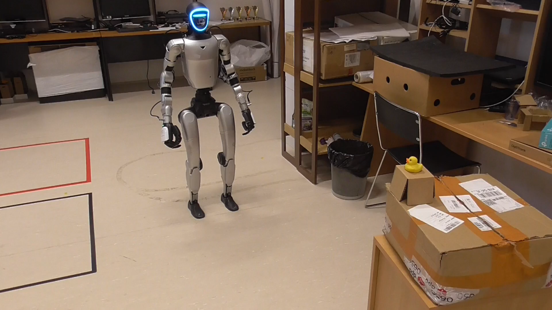
Robot and Sensors
Camera (RealSense D435i)
Light Detection and Ranging (LiDAR)
Leg & arm motors (Loco Client)
Speaker + microphone (AudioClient)
Interface Layers
Unitree SDK (low/high API)
Data Distribution Services (DDS)
Robot Operating System (ROS)
Motors and Sensors
How to find a duck
Capture RGB frame from RealSense D435i
Detect duck via euclidian similarity between feature vector from a precaptured image and camera image features
Calculate Euclidian distance from LiDAR data
Send walk command via LocoClient if object far away
Send turn command via LocoClient if object too close
If similarity high enough – turn slowly 90 degrees left and turn 180 degrees right.
Otherwise walk straight again.

